Slide 1
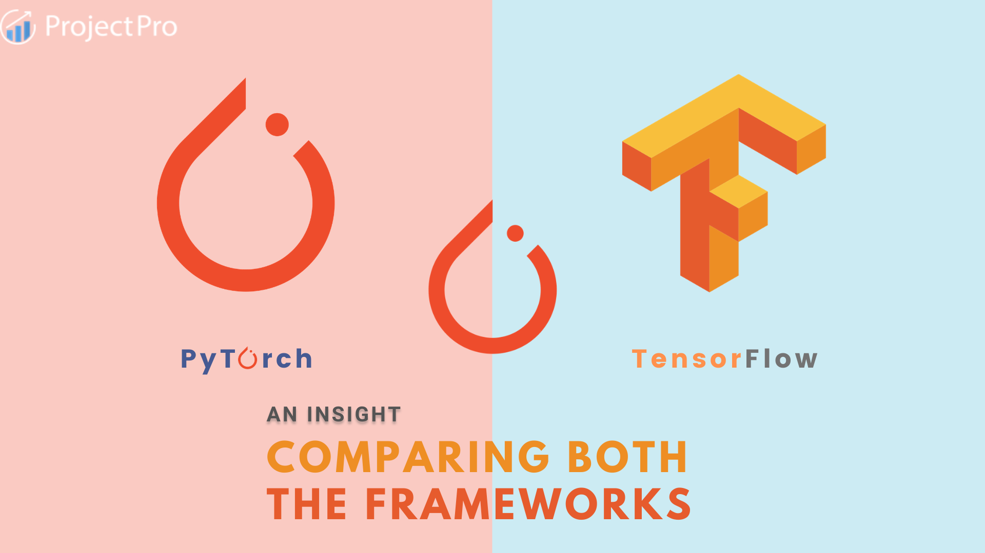

Slide 2
Introduction
Developed by Facebook AI Research, 2016.
Purpose: Research flexibility, ease of use.
Built on Torch (Lua), Python-based.
Developed by Google Brain, 2015.
Purpose: Scalable, production-ready ML systems.
Evolved from DistBelief, supports web/mobile/edge.

Slide 3
Key Features
Dynamic graphs for intuitive debugging.
Ecosystem: PyTorch Lightning, GPU-optimized.
Research-friendly, Pythonic syntax.
Static graphs for optimized deployment.
Ecosystem: TFX, TensorBoard, TensorFlow Lite.
Scalable for distributed training.

Slide 4
Real World Applications
Google Translate, AlphaGo.
2024 Case: Diabetic retinopathy detection (90% accuracy).
Meta AI’s LLaMA, Tesla Autopilot.
2025 Case: Edge-based object detection (20% less latency).

Slide 5
Comparative Perspective
Usability: PyTorch simpler for beginners; TensorFlow’s Keras eases high-level tasks.
Performance: PyTorch faster for research; TensorFlow for production.
Support: TensorFlow enterprise-backed; PyTorch research-focused.
Scalability: TensorFlow leads in distributed systems.

Slide 6
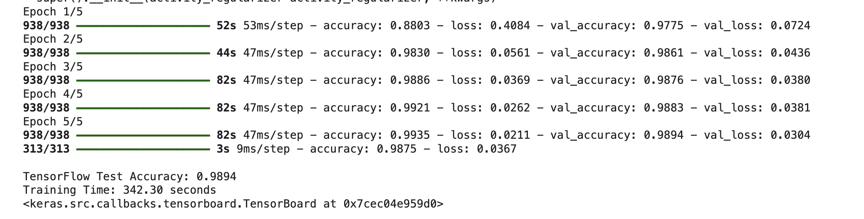
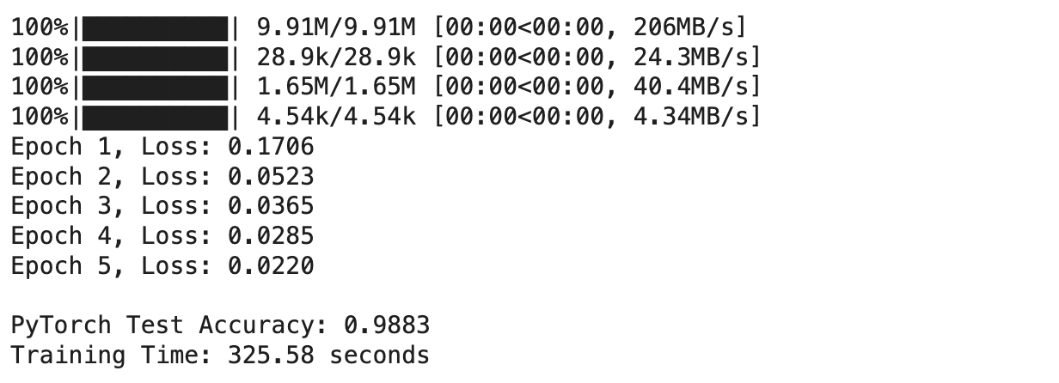
Demonstration

Slide 7
Conclusion
TensorFlow: Best for production, scalability.
PyTorch: Ideal for research, prototyping.
Recommendation: Choose based on project needs.

